Slide 1

7th Grade Accelerated Math
Unit 3, Lesson 9 Writing Small Numbers in Scientific Notation Volume 1, pg. 146

Slide 2


Benchmarks
MA.8.NSO.1.3
Extend previous understanding of the Laws of Exponents to include integer exponents. Apply the Laws of Exponents to evaluate numerical expressions and generate equivalent numerical expressions, limited to integer exponents and rational number bases, with procedural fluency.
MA.8.NSO.1.4
Express numbers in scientific notation to represent and approximate very large or very small quantities. Determine how many times larger or smaller one number is compared to a second number.
volume 1, pg. 146

Slide 3
Integrated Mathematical Thinking and Reasoning Standards
MA.K12.MTR.1.1 Actively participate in effortful learning both individually and collectively.
MA.K12.MTR.2.1 Demonstrate understanding by representing problems in multiple ways.
MA.K12.MTR.3.1 Complete tasks with mathematical fluency.
MA.K12.MTR.5.1 Use patterns and structure to help understand and connect mathematical concepts.
MA.K12.MTR.7.1 Apply mathematics to real-world contexts.
volume 1, pg. 146

Slide 4

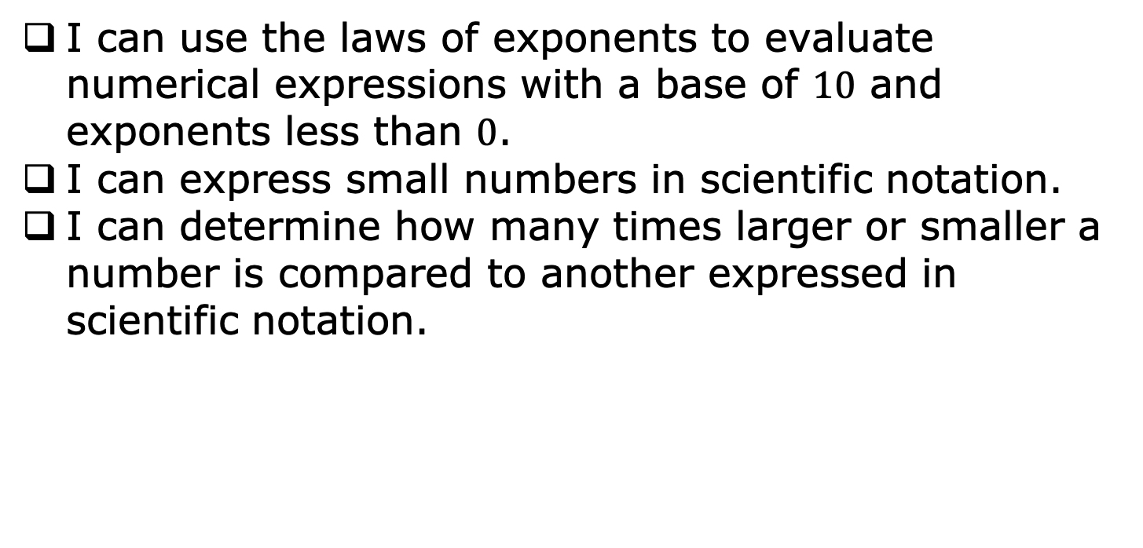
Learning Targets
I can use the laws of exponents to evaluate numerical expressions with a base of $10$ and exponents less than $0$.
I can express small numbers in scientific notation.
I can determine how many times larger or smaller a number is compared to another expressed in scientific notation.
volume 1, pg. 146

Slide 5

Warm-Up
volume 1, pg. 146

Slide 6
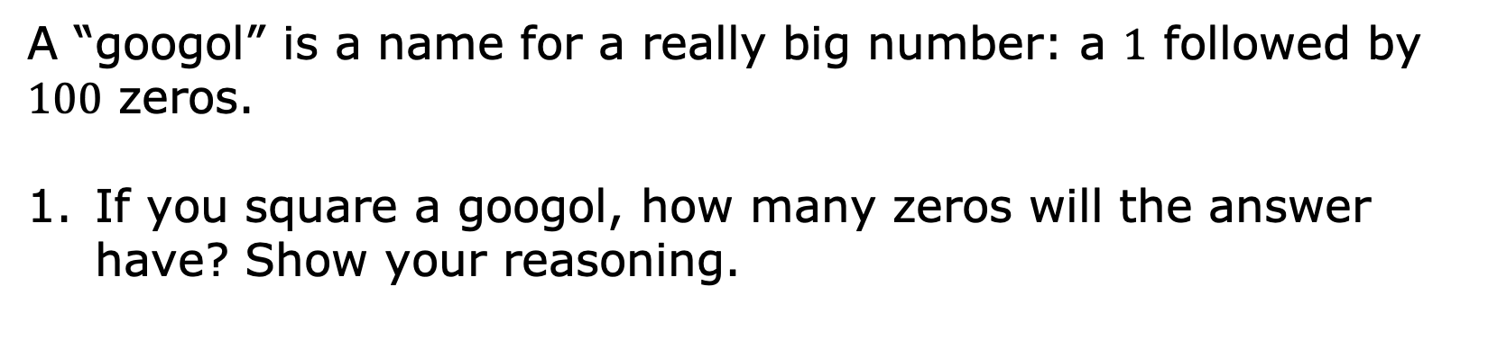
3.9.1 Warm-Up: Googol, not Google
A “googol” is a name for a really big number: a $1$ followed by $100$ zeros.
If you square a googol, how many zeros will the answer have? Show your reasoning.
volume 1, pg. 146

Slide 7

Exploration
volume 1, pg. 147

Slide 8

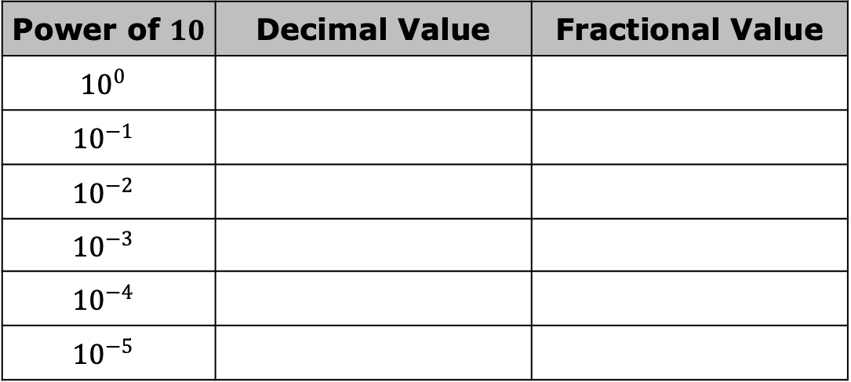
3.9.2 Exploration: Powers of Ten
Use a scientific calculator to find the decimal value of each. Then, write the equivalent fractional value.
Power of $10$ | Decimal Value | Fractional Value
$${10}^{0}$$
$${10}^{−1}$$
$${10}^{−2}$$
$${10}^{−3}$$
$${10}^{−4}$$
$${10}^{−5}$$
volume 1, pg. 147

Slide 9
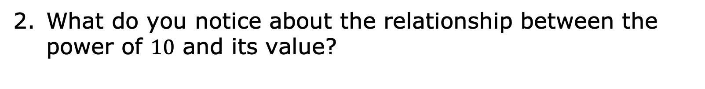
What do you notice about the relationship between the power of $10$ and its value?
volume 1, pg. 147

Slide 10
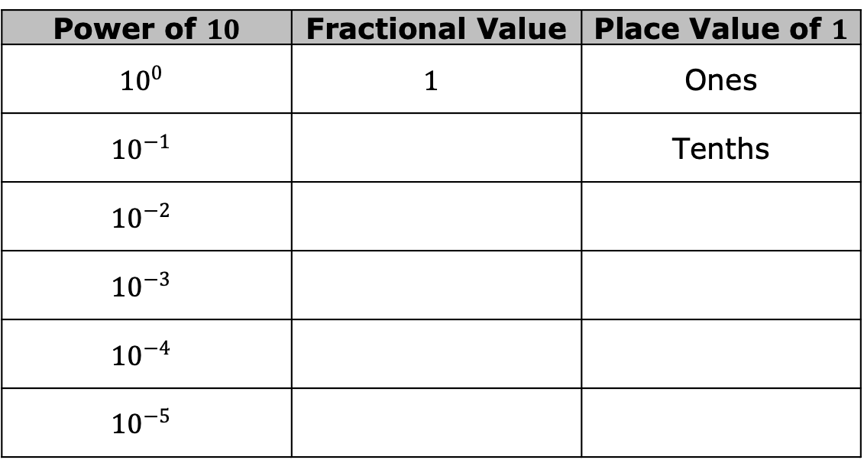
Work with your partner to complete the table.
Power of $10$ | Fractional Value | Place Value of $1$
$${10}^{0}$$ | $$1$$ | Ones
$${10}^{−1}$$ |  | Tenths
$${10}^{−2}$$
$${10}^{−3}$$
$${10}^{−4}$$
$${10}^{−5}$$
volume 1, pg. 147

Slide 11
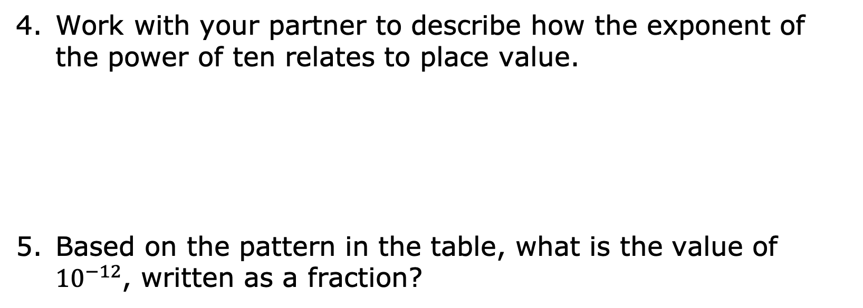
Work with your partner to describe how the exponent of the power of ten relates to place value.
Based on the pattern in the table, what is the value of ${10}^{−12}$, written as a fraction?
volume 1, pg. 147

Slide 12


Negative Powers of $10$
A base $10$ with a negative exponent can be rewritten as a fraction.
$${10}^{−a}= \frac{1}{{10}^{a}}$$
The value of the fraction relates directly to the place value of the $1$ when the quantity is expressed in its equivalent decimal form.
volume 1, pg. 147

Slide 13

Bring It Together
volume 1, pg. 148

Slide 14

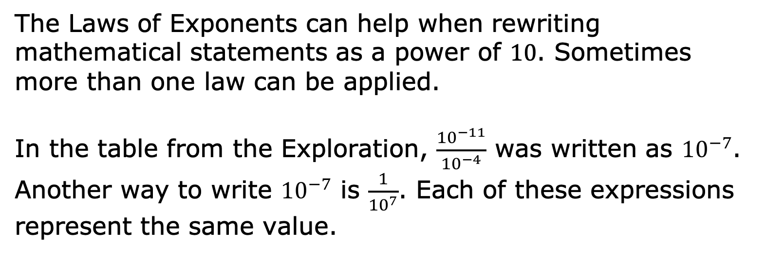
3.9.3 Bring It Together: Applying the Laws of Exponents
The Laws of Exponents can help when rewriting mathematical statements as a power of $10$. Sometimes more than one law can be applied.
In the table from the Exploration, $\frac{{10}^{−11}}{{10}^{−4}}$ was written as ${10}^{−7}$. Another way to write ${10}^{−7}$ is $\frac{1}{{10}^{7}}$. Each of these expressions represent the same value.
volume 1, pg. 148

Slide 15
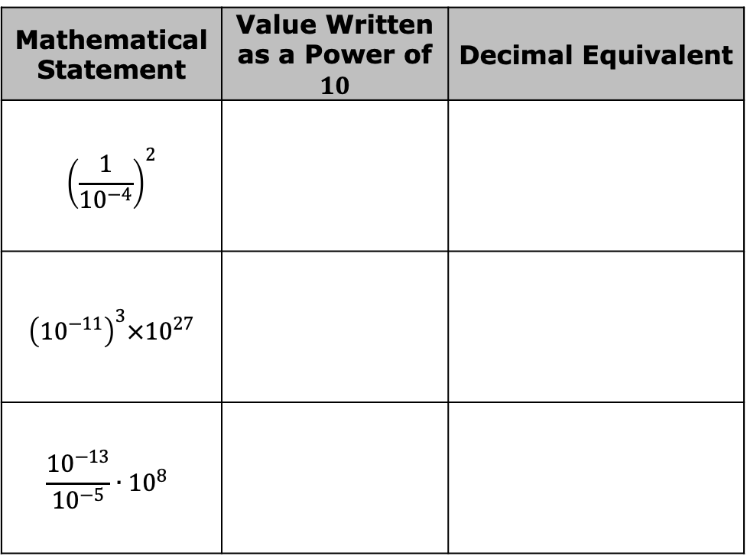
Write each mathematical statement in an equivalent form by applying one or more laws of exponents. Then, write the equivalent decimal value.
Mathematical Statement | Value Written as a Power of $10$ | Decimal Equivalent
$${\left(\frac{1}{{10}^{−4}}\right)}^{2}$$
$${\left({10}^{−11}\right)}^{3}×{10}^{27}$$
$$\frac{{10}^{−13}}{{10}^{−5}}∙{10}^{8}$$
volume 1, pg. 148

Slide 16
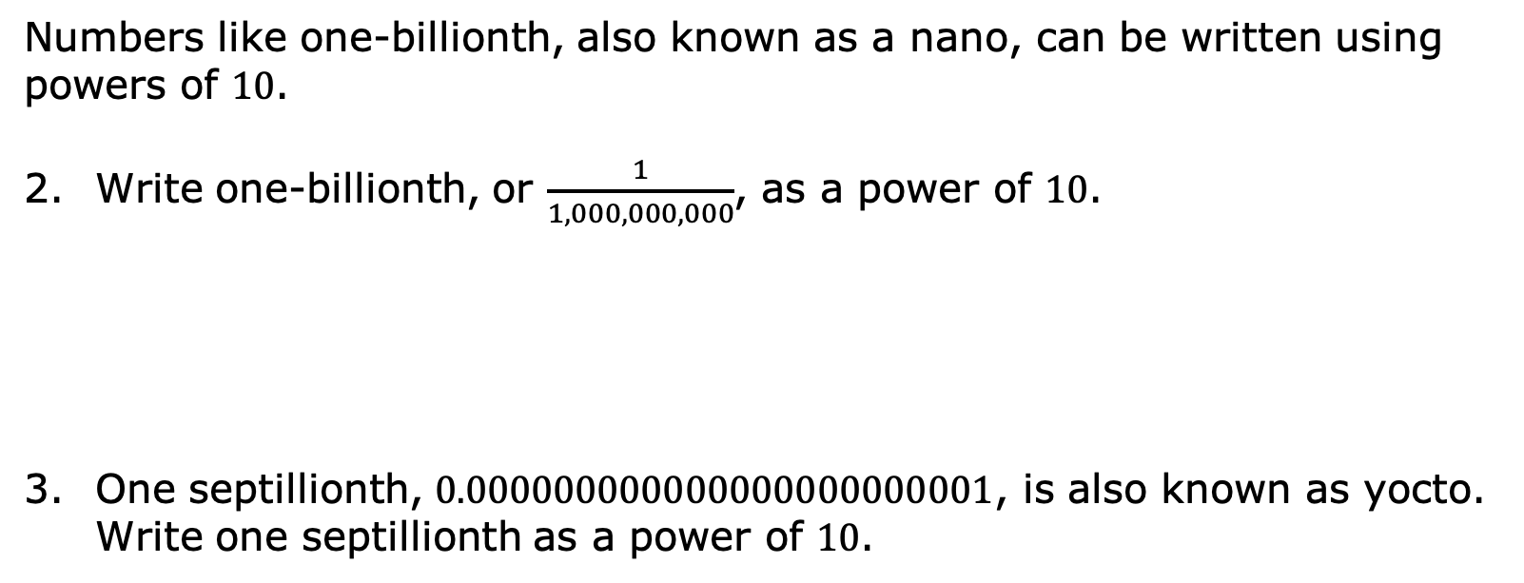
Numbers like one-billionth, also known as a nano, can be written using powers of $10$.
Write one-billionth, or $\frac{1}{1,000,000,000}$, as a power of $10$.
One septillionth, $0.000000000000000000000001$, is also known as yocto. Write one septillionth as a power of $10$.
volume 1, pg. 148

Slide 17

Guided Instruction
volume 1, pg. 149

Slide 18
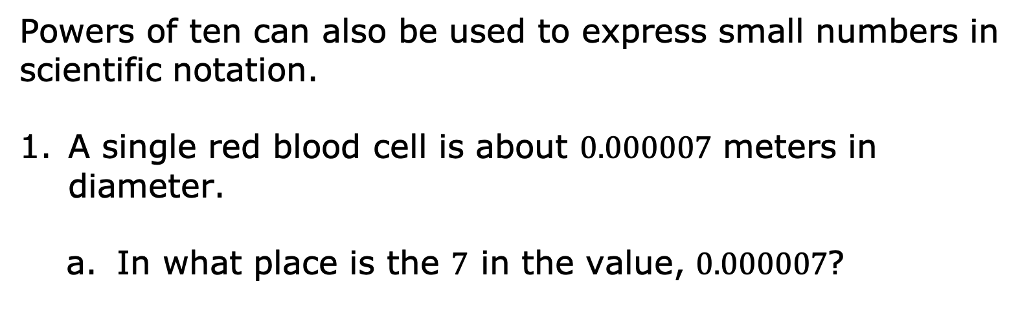
3.9.4 Guided Instruction: Writing Small Numbers in Scientific Notation
Powers of ten can also be used to express small numbers in scientific notation.
A single red blood cell is about $0.000007$ meters in diameter.
In what place is the $7$ in the value, $0.000007$?
volume 1, pg. 149

Slide 19
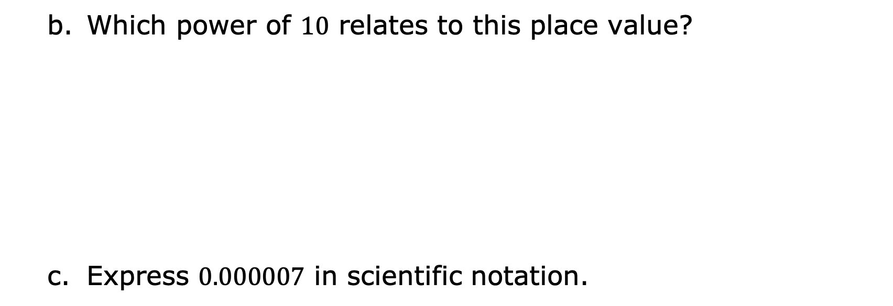
Which power of $10$ relates to this place value?
Express $0.000007$ in scientific notation.
volume 1, pg. 149

Slide 20
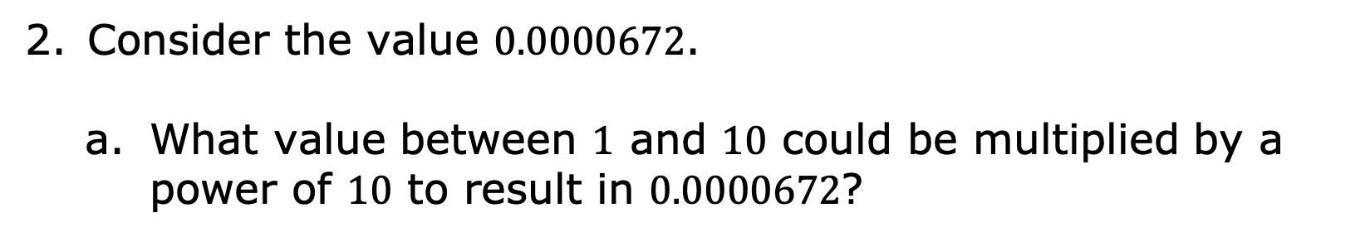
Consider the value $0.0000672$.
What value between $1$ and $10$ could be multiplied by a power of $10$ to result in $0.0000672$?
volume 1, pg. 149

Slide 21
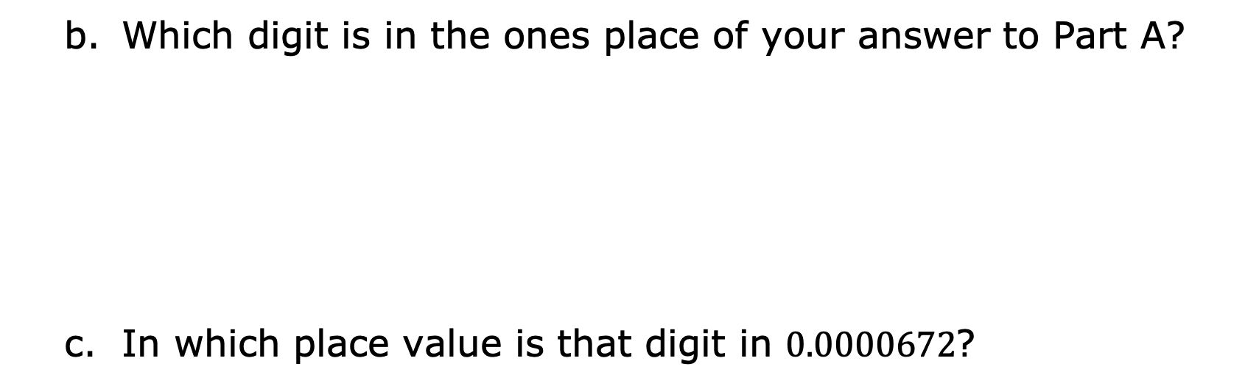
Which digit is in the ones place of your answer to Part A?
In which place value is that digit in $0.0000672$?
volume 1, pg. 149

Slide 22
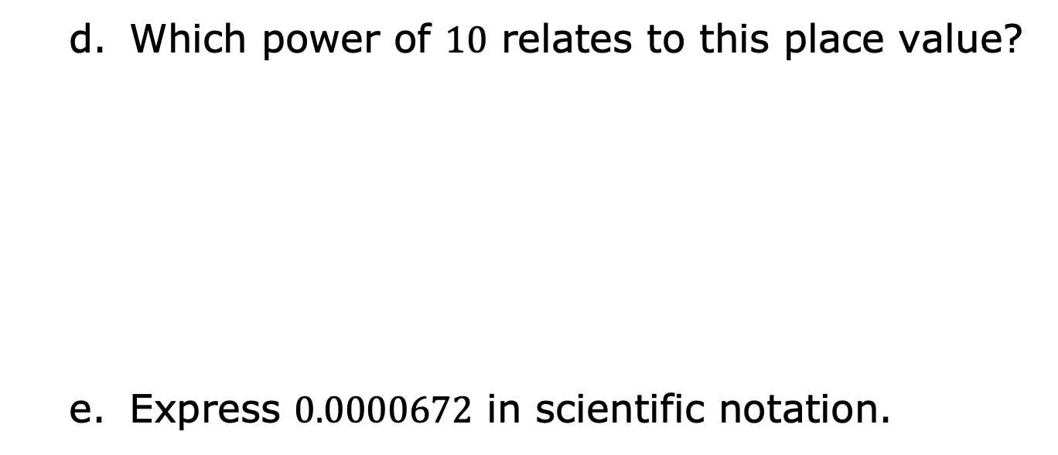
Which power of $10$ relates to this place value?
Express $0.0000672$ in scientific notation.
volume 1, pg. 149

Slide 23
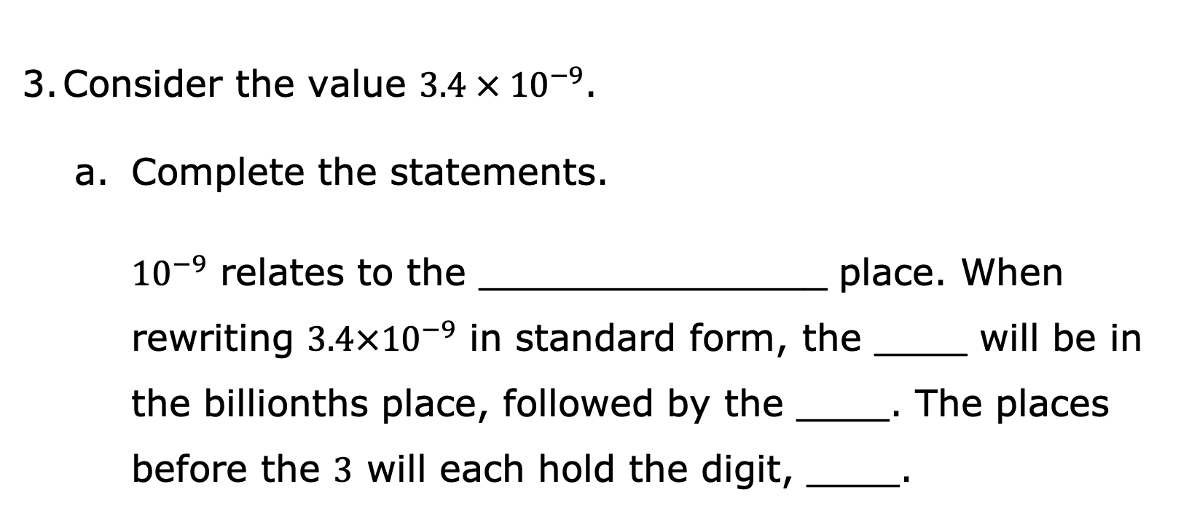
Consider the value $3.4 × {10}^{−9}$.
Complete the statements.
${10}^{−9}$ relates to the _______________ place. When rewriting $3.4×{10}^{−9}$ in standard form, the ____ will be in the billionths place, followed by the ____. The places before the $3$ will each hold the digit, ____.
volume 1, pg. 149

Slide 24
Express this value in standard form.
volume 1, pg. 149

Slide 25

Guided Practice
volume 1, pg. 150

Slide 26

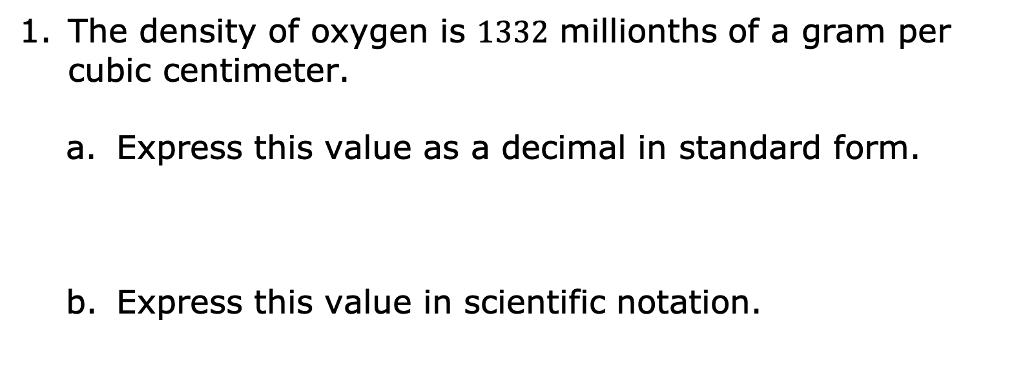
3.9.5 Guided Practice: Writing Small Numbers in Scientific Notation
The density of oxygen is $1332$ millionths of a gram per cubic centimeter.
Express this value as a decimal in standard form.
Express this value in scientific notation.
volume 1, pg. 150

Slide 27
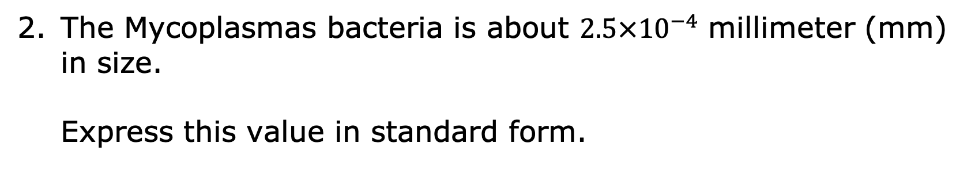
The Mycoplasmas bacteria is about $2.5×{10}^{−4}$ millimeter (mm) in size.
Express this value in standard form.
volume 1, pg. 150

Slide 28

Collaboration
volume 1, pg. 150

Slide 29

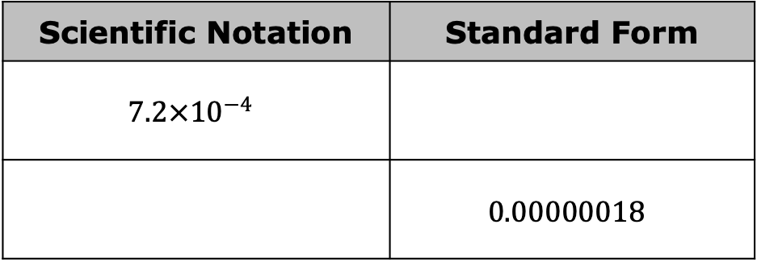
3.9.6 Collaboration: Comparing Small Numbers Written in Scientific Notation
Work with your partner to complete the following.
Complete the table.
Scientific Notation | Standard Form
$$7.2×{10}^{−4}$$
 | $$0.00000018$$
volume 1, pg. 150

Slide 30
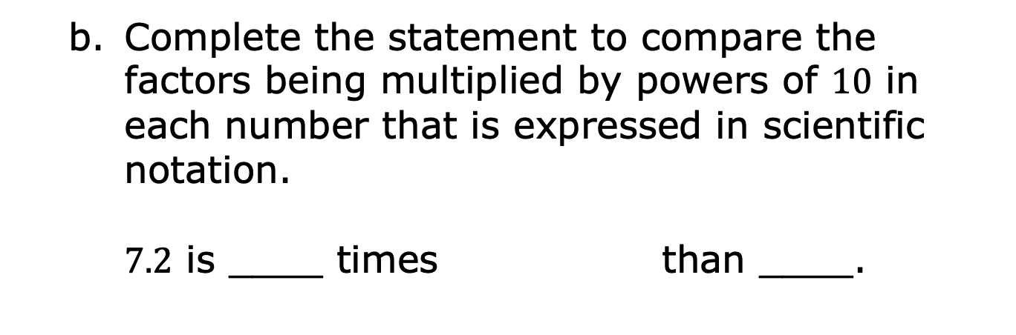
Complete the statement to compare the factors being multiplied by powers of $10$ in each number that is expressed in scientific notation.
$7.2$ is ____ times than ____.
smaller
larger
volume 1, pg. 150

Slide 31
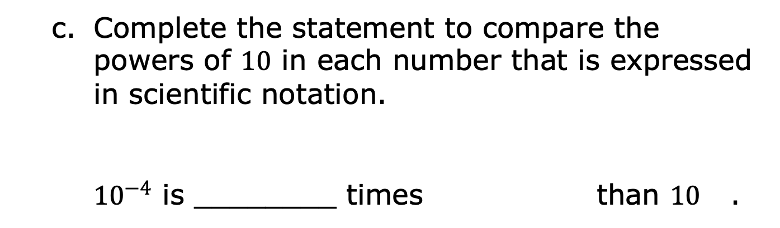
Complete the statement to compare the powers of $10$ in each number that is expressed in scientific notation.
${10}^{−4}$ is ________ times than $10$ .
smaller
larger
volume 1, pg. 150

Slide 32
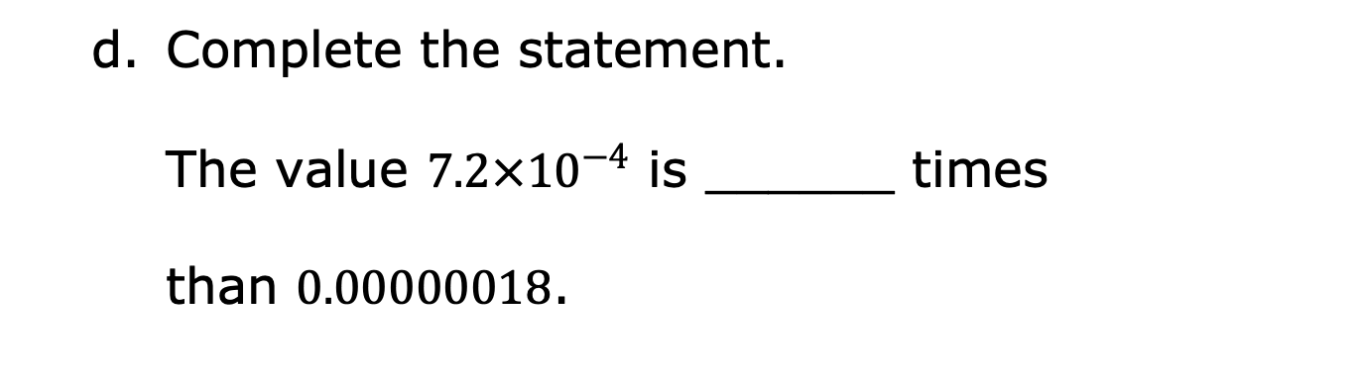
Complete the statement.
The value $7.2×{10}^{−4}$ is ______ times
than $0.00000018$.
smaller
larger
volume 1, pg. 150

Slide 33

Wrap-Up
volume 1, pg. 151

Slide 34
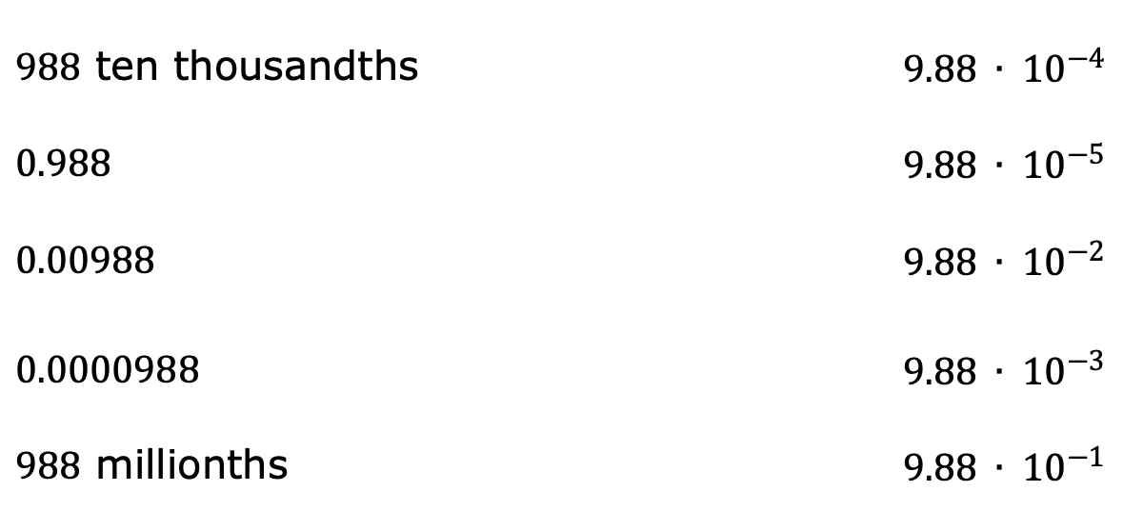
3.9.7 Wrap-Up: Ticket Out the Door
Match each value on the left with its expression in scientific notation on the right by drawing lines to connect the equivalent expressions.
$988$ ten thousandths | $9.88 ∙ {10}^{−4}$
$0.988$ | $9.88 ∙ {10}^{−5}$
$$0.00988$$ | $9.88 ∙ {10}^{−2}$
$0.0000988$ | $9.88 ∙ {10}^{−3}$
$988$ millionths | $9.88 ∙ {10}^{−1}$
volume 1, pg. 151

